Slide 1
Chapter 7: Nutrients Essential to Fluid and Electrolyte Balance, and In Depth 7.5, Alcohol

Slide 2
Fluids
Substances composed of freely moving molecules
Have the ability to conform to the shape of the container that holds them
There are different types of fluids in our bodies
Two-thirds of the body’s fluid is intracellular fluid
The remaining one-third is extracellular fluid

Slide 3
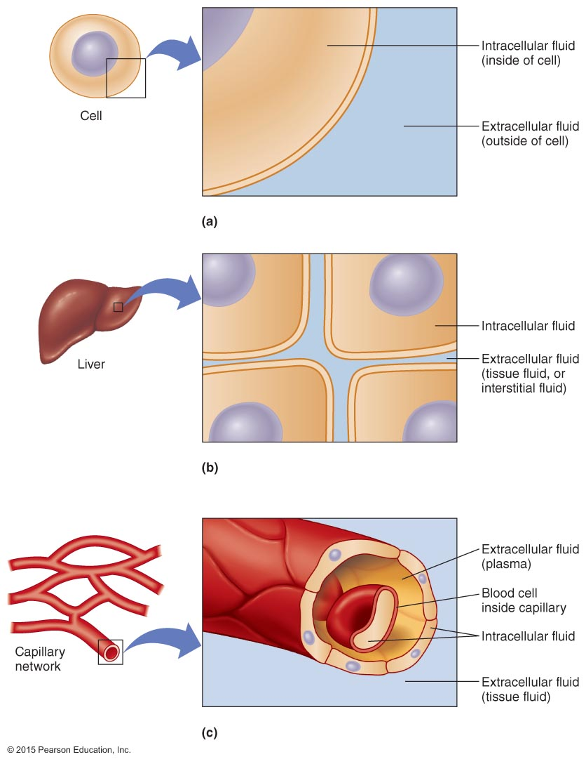
Components of Body Fluid

Slide 4
Fluids (cont.)
Extracellular fluids include
Tissue fluid, found between the cells within tissues and organs of the body
Plasma, the fluid portion of blood that carries the blood cells

Slide 5
Fluids (cont.)
The body fluid composition of tissue varies by
Tissue type—lean tissues have higher fluid content than fat tissues
Gender—males have more lean tissue and therefore more body fluid
Age—lean tissue is lost with age, and body fluid is lost with it

Slide 6
Electrolytes
In intracellular fluid, K⁺ and HPO₄^{2–} are the predominant electrolytes
In extracellular fluid, Na⁺ and Cl– predominate
There is a slight electrical charge difference on either side of the cell membrane

Slide 7
Functions of Fluids
Fluids dissolve and transport substances
Water is an excellent solvent because it can dissolve many different substances
The dissolved materials, or solutes, include ions, carbohydrates, amino acids, vitamins, and minerals

Slide 8
Functions of Fluids (cont.)
Fluids account for blood volume
Blood volume is the amount of fluid in the blood
Increased blood volume can cause blood pressure to rise (hypertension)
Decreased blood volume can cause low blood pressure

Slide 9
Functions of Fluids (cont.)
Fluids help maintain body temperature
Because water has a high heat capacity, the temperature of our body fluids remains quite stable
Sweating releases heat as the evaporation of water from the skin cools the skin and blood

Slide 10
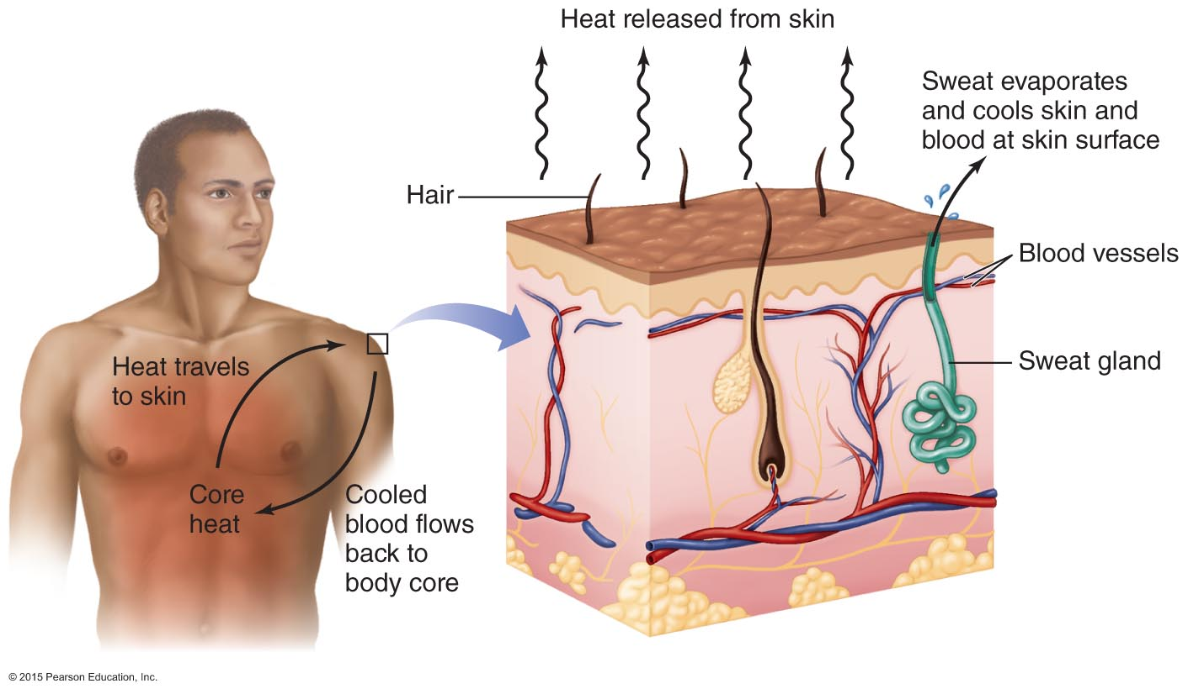
Fluids Help Maintain Body Temperature

Slide 11
Functions of Fluids (cont.)
Fluids protect and lubricate our tissues
Cerebrospinal fluid protects the brain and spinal column
Amniotic fluid protects the fetus
Synovial fluid is a lubricant around joints
Digestive secretions allow for easy passage of material
Pleural fluid covering the lungs allows friction-free expansion and retraction

Slide 12
Functions of Electrolytes
Electrolytes help regulate fluid balance
Water follows the movement of electrolytes, moving by osmosis to areas where the concentration of electrolytes is high
This allows for the controlled movement of fluids into and out of cells

Slide 13
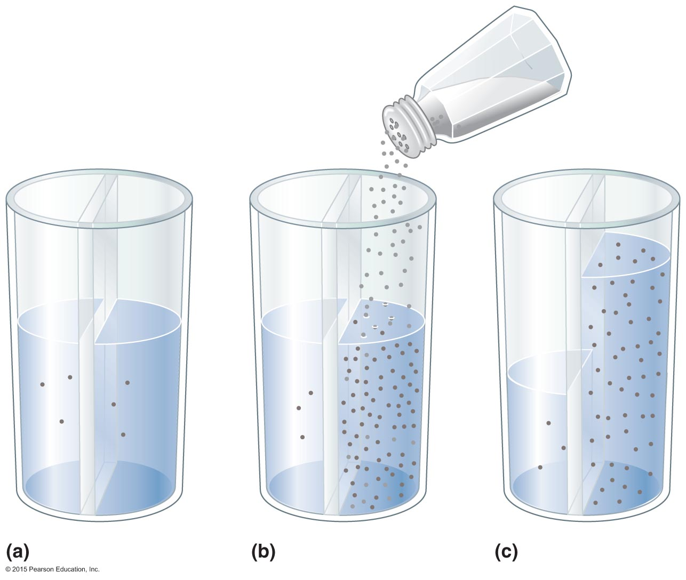
Osmosis

Slide 14
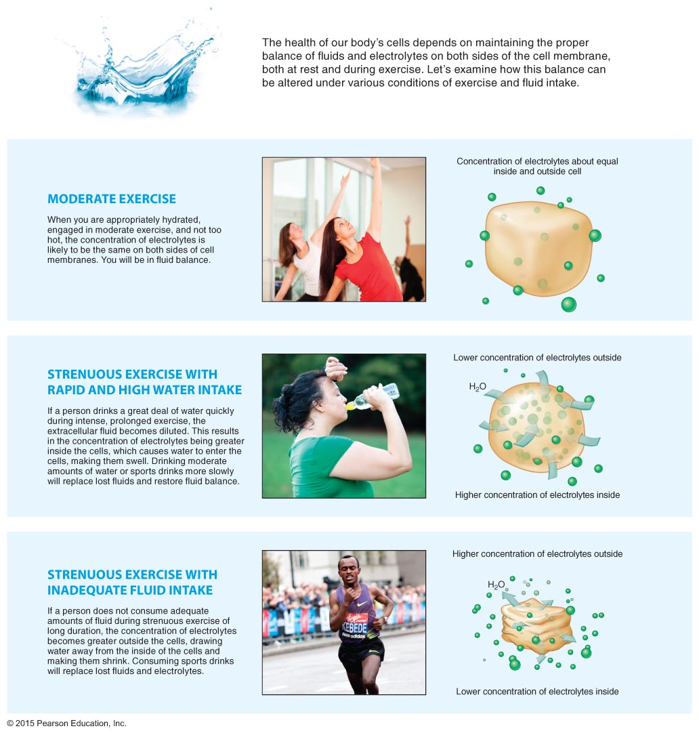
Fluid and Electrolyte Balance

Slide 15
Functions of Electrolytes (cont.)
Electrolytes enable our nerves to respond to stimuli
Movement of sodium (Na⁺) and potassium (K⁺) across the membranes of nerve cells changes the electrical charge across the membrane
This change in electrical charge carries the nerve impulse along the nerve cell

Slide 16
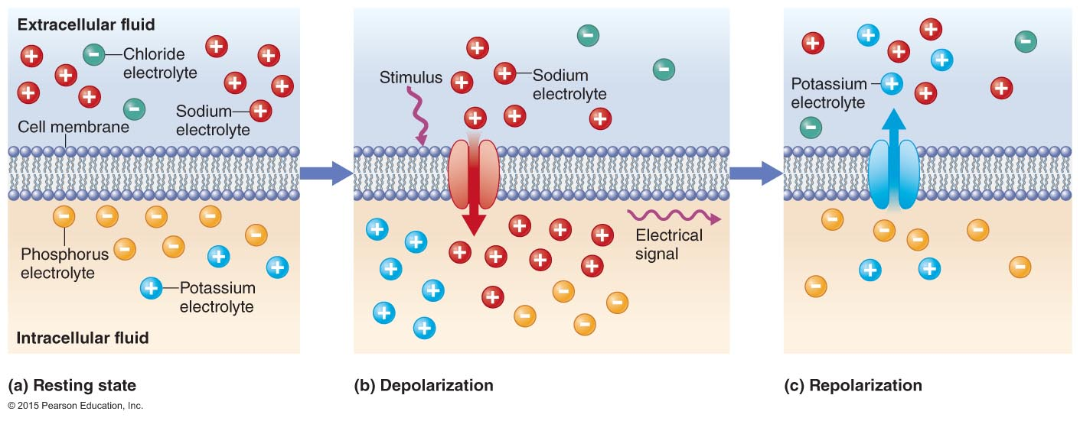
Role of Electrolytes in Nerve Function

Slide 17
Functions of Electrolytes (cont.)
Electrolytes signal our muscles to contract
The movement of calcium (Ca²⁺) into a muscle cell stimulates the muscle to contract
The Ca²⁺ is pumped back out of the cell after the muscle contraction

Slide 18
Maintaining Fluid Balance
Fluid balance is maintained by different mechanisms prompting us to drink and retain fluid
The thirst mechanism occurs from a cluster of nerve cells (in the hypothalamus) that stimulate our desire to drink
However, the thirst mechanism is not always sufficient; the amount of fluids people drink may not be enough to achieve fluid balance

Slide 19
Maintaining Fluid Balance (cont.)
Water lost from the body must be replaced
Water is lost through urine, sweat, evaporation, exhalation, and feces
Water is gained through beverages, food, and metabolic reactions
Metabolic water contributes about 10–14% of the water the body needs

Slide 20
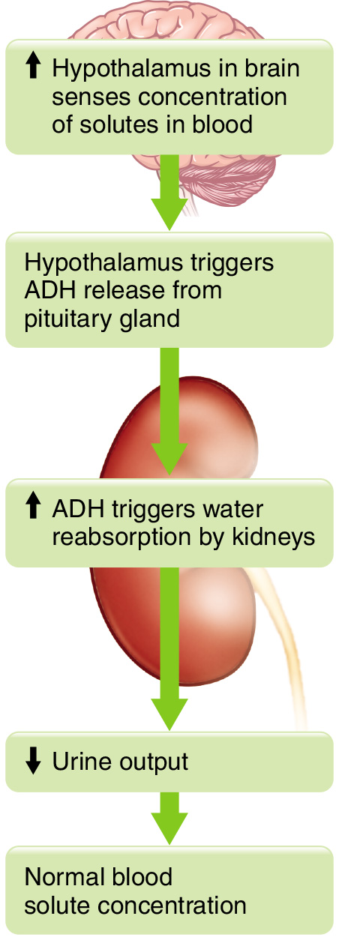
Fluid Balance

Slide 21
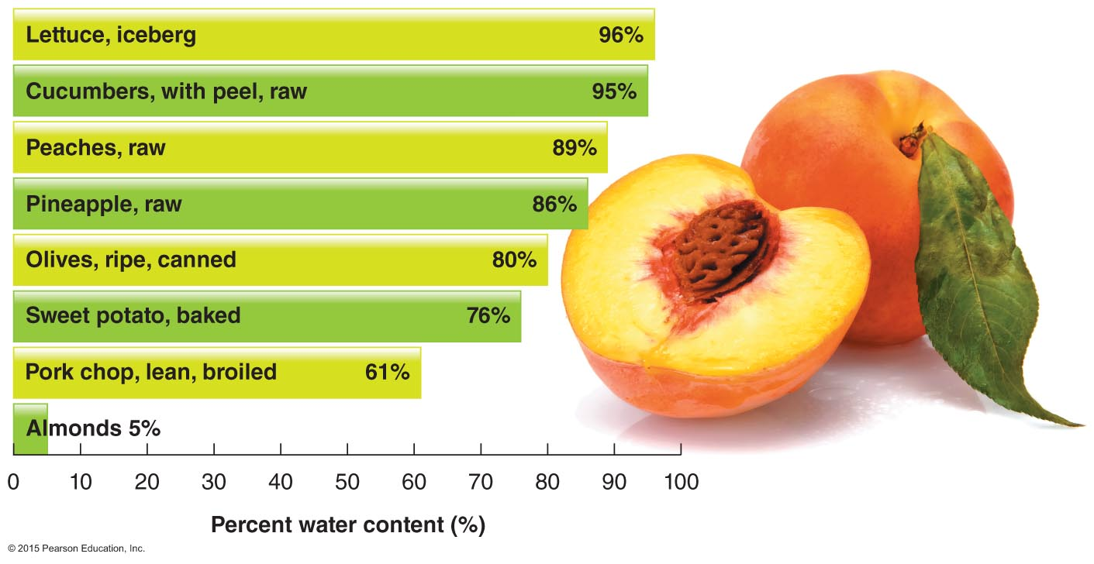
Water Content of Various Foods

Slide 22
Maintaining Fluid Balance (cont.)
Loss of water
Sensible water loss occurs through urine and sweat
Most water is lost through urine
The kidneys control how much water is reabsorbed; excess water is processed by the kidneys and excreted as urine
Insensible water loss occurs through evaporation from the skin or exhalation from the lungs, as well as through feces
Diuretics increase fluid loss via the urine

Slide 23
Water
Functions of water
Essential for life
Required for fluid and electrolyte balance and many metabolic reactions
Recommended intake
Varies with environment and activity level

Slide 24
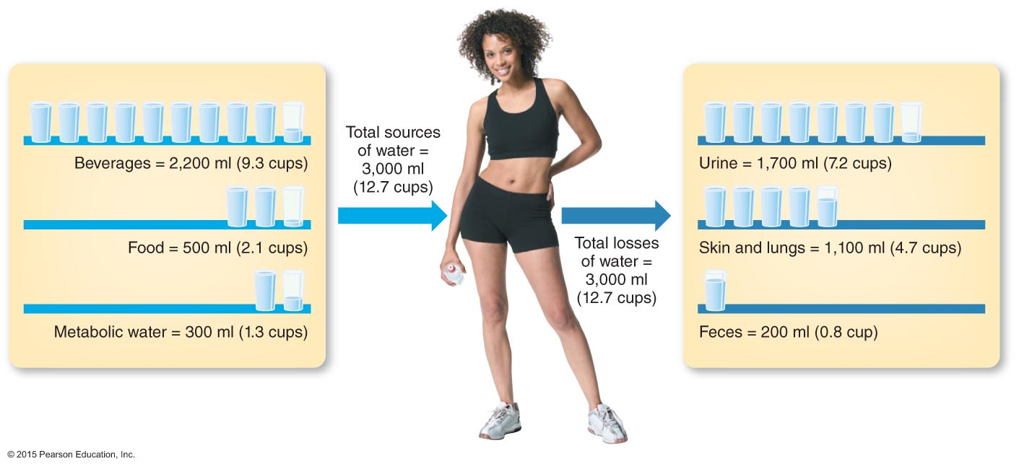
For a Woman Expending 2,500 kcal/day

Slide 25
Water (cont.)
Surface water comes from lakes, rivers, and reservoirs
Groundwater comes from underground rock formations called aquifers
“Hard water” is relatively high in calcium
The U.S. Environmental Protection Agency (EPA) sets and monitors standards for public water systems and is responsible for regulation of bottled water

Slide 26
Water (cont.)
What if you drink too much water?
Becoming overhydrated is rare
Can result in a dilution of sodium (hyponatremia)
What if you don’t drink enough water?
Dehydration
Infants and the elderly are especially vulnerable

Slide 27
Commercial Beverages
Low-fat and skim milk provide protein, calcium, phosphorus, vitamin D, and, usually, vitamin A
Moderate consumption of beverages with caffeine is safe and potentially healthful
Most soft drinks, juice drinks, flavored waters, and bottled tea and coffee drinks are loaded with added sugars
“Designer waters” with added nutrients and/or herbs can add more than 300 Calories to the day’s intake and rarely contribute to better health

Slide 28
Commercial Beverages (cont.)
Many energy drinks, typically consumed quickly, contain a high amount of caffeine, which can cause a dramatic rise in blood pressure and heart rate
They also contain a significant amount of added sugar

Slide 29
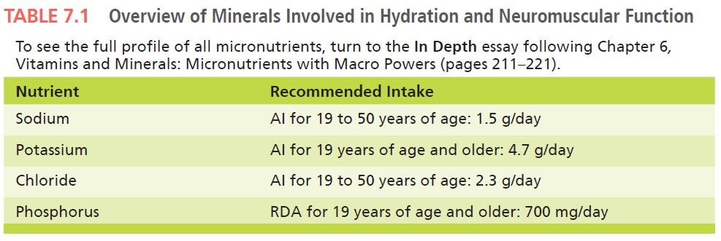
Minerals in Hydration

Slide 30
Sodium
Functions of sodium
Fluid and electrolyte balance
Associated with blood pressure and pH balance in the body
Required for nerve impulse transmission
Assists in the transport of certain nutrients (e.g., glucose) into body cells

Slide 31
Sodium (cont.)
Recommended intake
1.5 g/day is required
No more than 2.3 g/day is recommended
Sources of sodium
Processed foods and restaurant foods are generally high in sodium

Slide 32
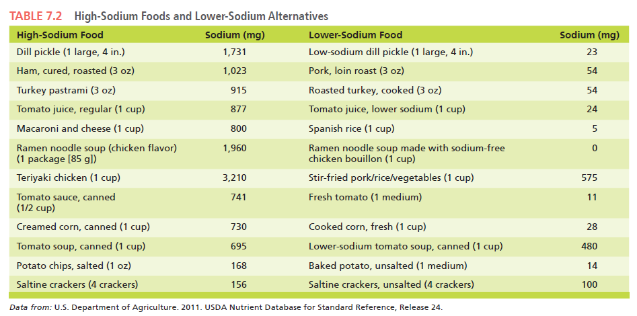
High-Sodium Foods and Alternatives

Slide 33
Sodium (cont.)
What if you consume too much sodium?
Hypernatremia: abnormally high blood sodium concentration
Can occur in patients with congestive heart failure or kidney disease
Results in high blood volume, edema, and high blood pressure

Slide 34
Sodium (cont.)
What if you don’t consume enough sodium?
Hyponatremia: an abnormally low blood sodium level
Can result from prolonged vomiting, diarrhea, or sweating
Has been seen in marathon athletes who consume too much water and fail to replace sodium

Slide 35
Potassium
Functions of potassium
Fluid and electrolyte balance
Very important in muscle contractions and transmission of nerve impulses
High potassium intake helps to maintain a lower blood pressure

Slide 36
Potassium (cont.)
Recommended intake
4.7 g/day
Sources of potassium
Processed foods are usually low in potassium
Fresh fruit and vegetables and whole grains are good sources of potassium

Slide 37
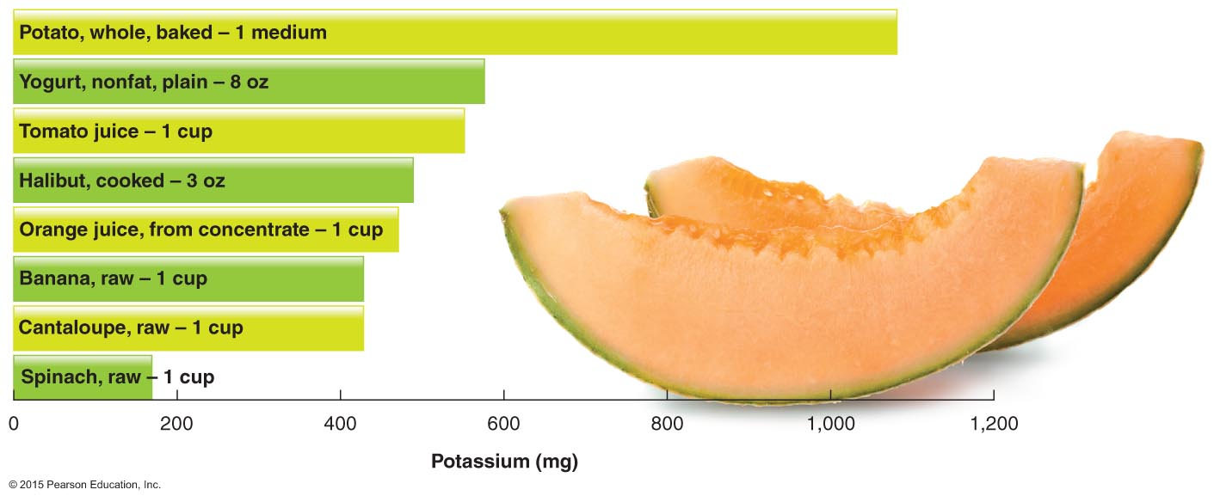
Common Food Sources of Potassium

Slide 38
Potassium (cont.)
What if you consume too much potassium?
Hyperkalemia: a high blood potassium level
Can occur in patients with kidney disease
Can alter normal heart rhythm, resulting in a heart attack

Slide 39
Potassium (cont.)
What if you don’t consume enough potassium?
Hypokalemia: a low blood potassium level
Can be seen in patients with kidney disease or diabetic acidosis
Can occur when taking certain diuretic medications

Slide 40
Chloride
Functions of chloride
Assists with maintaining fluid balance
Assists the immune system
Component of HCl in the stomach
Recommended intake
Minimum recommendation is 2.3 g/day

Slide 41
Chloride (cont.)
What if you consume too much chloride?
May lead to hypertension in salt-sensitive patients
What if you don’t consume enough chloride?
This is rare but can occur in people with eating disorders

Slide 42
Phosphorus
Functions of phosphorus
The major intracellular negatively charged electrolyte
Required for fluid balance
Critical role in bone formation (85% of body’s phosphorus is found in bone)
Regulates biochemical pathways by activating or deactivating enzymes
Found in ATP, DNA, RNA

Slide 43
Phosphorus (cont.)
Recommended intake
Recommended Dietary Allowance (RDA) for phosphorus is 700 mg/day
Sources of phosphorus
Widespread in many foods
Found in high amounts in foods that contain protein (e.g., meat, milk, eggs)

Slide 44
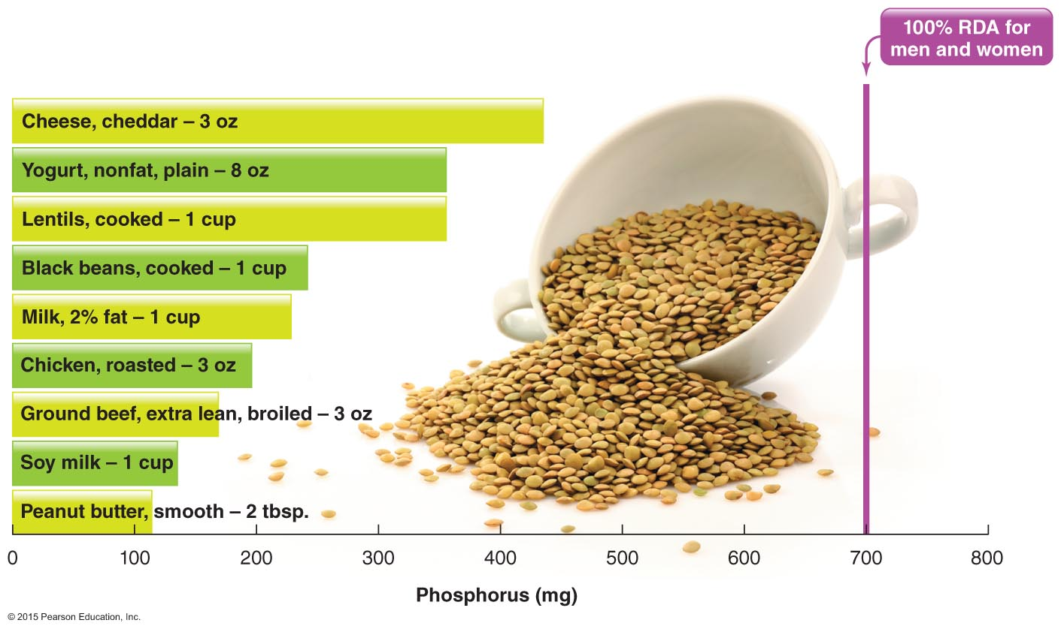
Common Food Sources of Phosphorus

Slide 45
Phosphorus (cont.)
What if you consume too much phosphorus?
High blood levels of phosphorus can occur with kidney disease or when taking too many vitamin D supplements
Causes muscle spasms, convulsions
What if you don’t consume enough phosphorus?
Deficiencies of phosphorus are rare

Slide 46
Fluid and Electrolyte Balance Disorders
Serious health problems that can occur when fluid excretion exceeds intake include
Dehydration occurs when fluid excretion exceeds fluid intake
Heat illnesses
Heat cramps
Heat exhaustion
Heat stroke

Slide 47
Dehydration
Dehydration occurs when water loss exceeds water intake
Commonly due to heavy exercise or high environmental temperatures
Infants and the elderly are more at risk

Slide 48
Dehydration (cont.)
Other common causes of dehydration include
Diarrhea
Vomiting
Fever
Burns, including sunburn
Poorly controlled diabetes
Abuse of diuretics or laxatives

Slide 49
Dehydration (cont.)
Dehydration is classified in terms of percentage of weight loss that is exclusively due to the loss of fluids

Slide 50
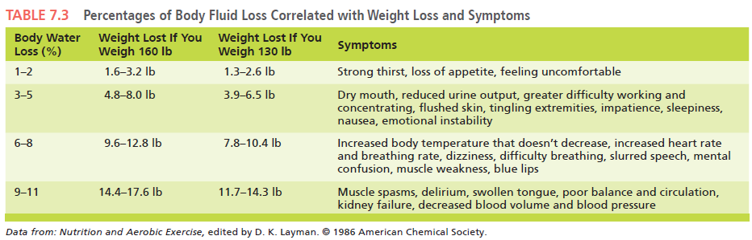
Classifying Dehydration

Slide 51
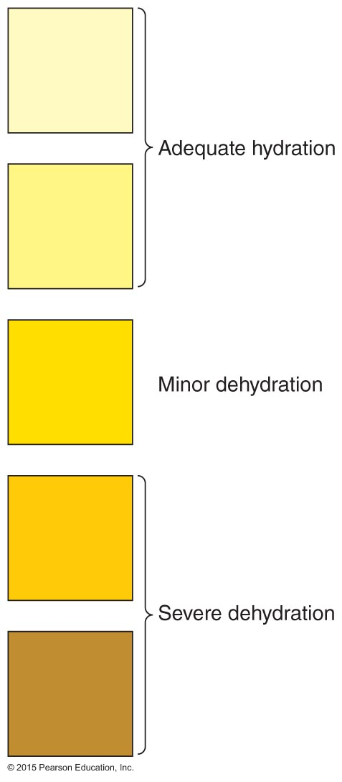
Using Urine Color to Gauge Hydration

Slide 52
Heat Illnesses
Three common types of heat illnesses closely linked to dehydration are
Heat cramps
Heat exhaustion
Heatstroke

Slide 53
Heat Cramps
Painful muscle cramps, usually in the abdomen, arms, or legs
Develop during vigorous activity sessions in the heat
Spasms can last seconds or minutes
Important to stop activity immediately, cool down, and rest; cramps may signal a more serious problem

Slide 54
Heat Exhaustion
Typically occurs from vigorous activity in heat
May develop after several days in high heat when fluids are inadequate
Symptoms include cramps, weakness, vomiting, dizziness, and elevated blood pressure and pulse
Must be treated promptly and aggressively to prevent heatstroke from developing

Slide 55
Heatstroke
Heatstroke occurs if the body’s temperature regulation mechanisms fail
Occurs in hot, humid environments
Symptoms include rapid pulse, hot and dry skin, high body temperature, and weakness
Has been fatal for athletes during exercise in extreme heat
If it occurs, provide immediate cooling and rest, and contact emergency medical help quickly

Slide 56
In Depth: Alcohol
Alcohols are chemical compounds characterized by a hydroxyl group
In common usage, beverages containing ethanol made from fermented fruits, vegetables, or grains

Slide 57
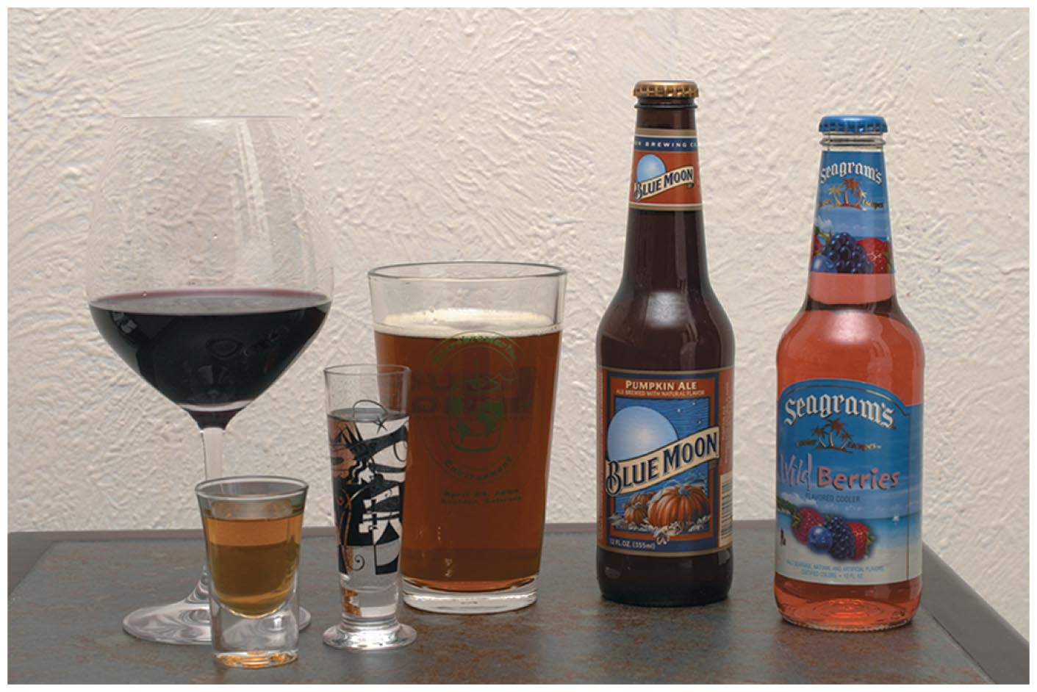
What Does One Drink Look Like?

Slide 58
In Depth: Alcohol (cont.)
What is moderate alcohol intake?
A drink is defined as the amount of a beverage that provides ½ fluid ounce of pure alcohol
Proof is a measurement of alcohol content
Moderate alcohol intake is defined as the consumption of up to one drink per day for women, and up to two drinks per day for men

Slide 59
In Depth: Alcohol (cont.)
Benefits of moderate consumption include
Stress and anxiety reduction
Appetite improvement
Lower rates of heart disease
Possible lower risks for diseases such as diabetes, heart disease, and liver disease

Slide 60
In Depth: Alcohol (cont.)
Concerns about moderate alcohol intake include
Women appear to be at higher risk for breast cancer
Increased risk for hypertension
Higher rates of bleeding in the brain
Relatively high Calorie content
Potential risk for adverse drug interactions

Slide 61
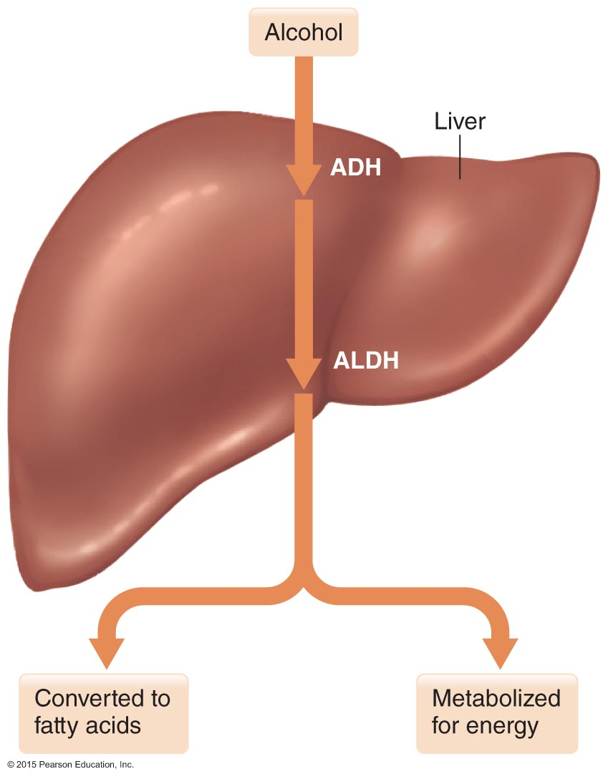
Metabolism of Alcohol

Slide 62
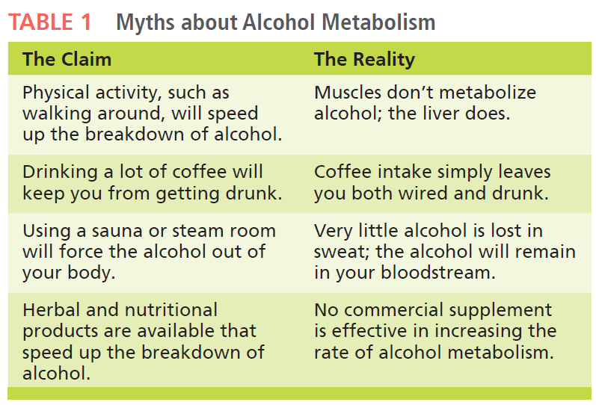
Myths About Alcohol Metabolism

Slide 63
Alcohol
Alcohol use disorder (AUD)
Medical diagnosis for problem drinking that has become severe and is characterized by either abuse or dependence

Slide 64
In Depth: Alcohol (cont.)
Types of alcohol abuse:
Alcohol abuse is excessive intake of alcohol
Binge drinking is consumption of five or more drinks per occasion
Alcoholism is a disease characterized by chronic dependence on alcohol

Slide 65
In Depth: Alcohol (cont.)
Effects of alcohol abuse:
A hangover is a consequence of drinking too much alcohol; symptoms include headache, fatigue, dizziness, muscle aches, and nausea
Even at low intakes, alcohol impairs reasoning and judgment
Alcohol poisoning is a potentially fatal metabolic state involving cardiac or respiratory failure
Alcohol abuse can lead to traumatic injury from falls, drownings, assaults, and traffic accidents

Slide 66
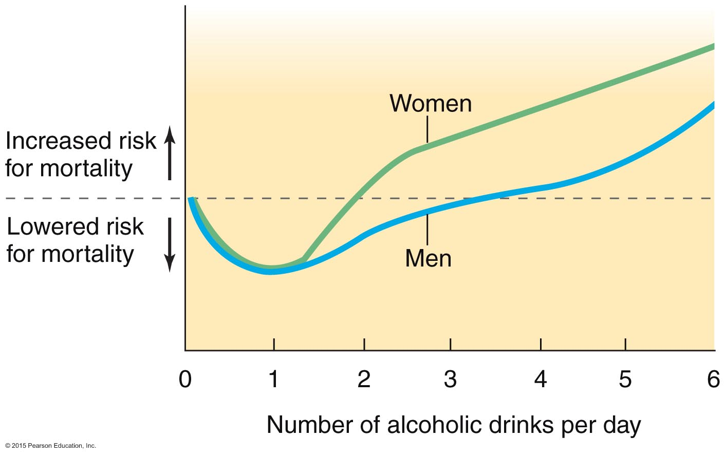
Effects of Alcohol on Mortality Risk

Slide 67
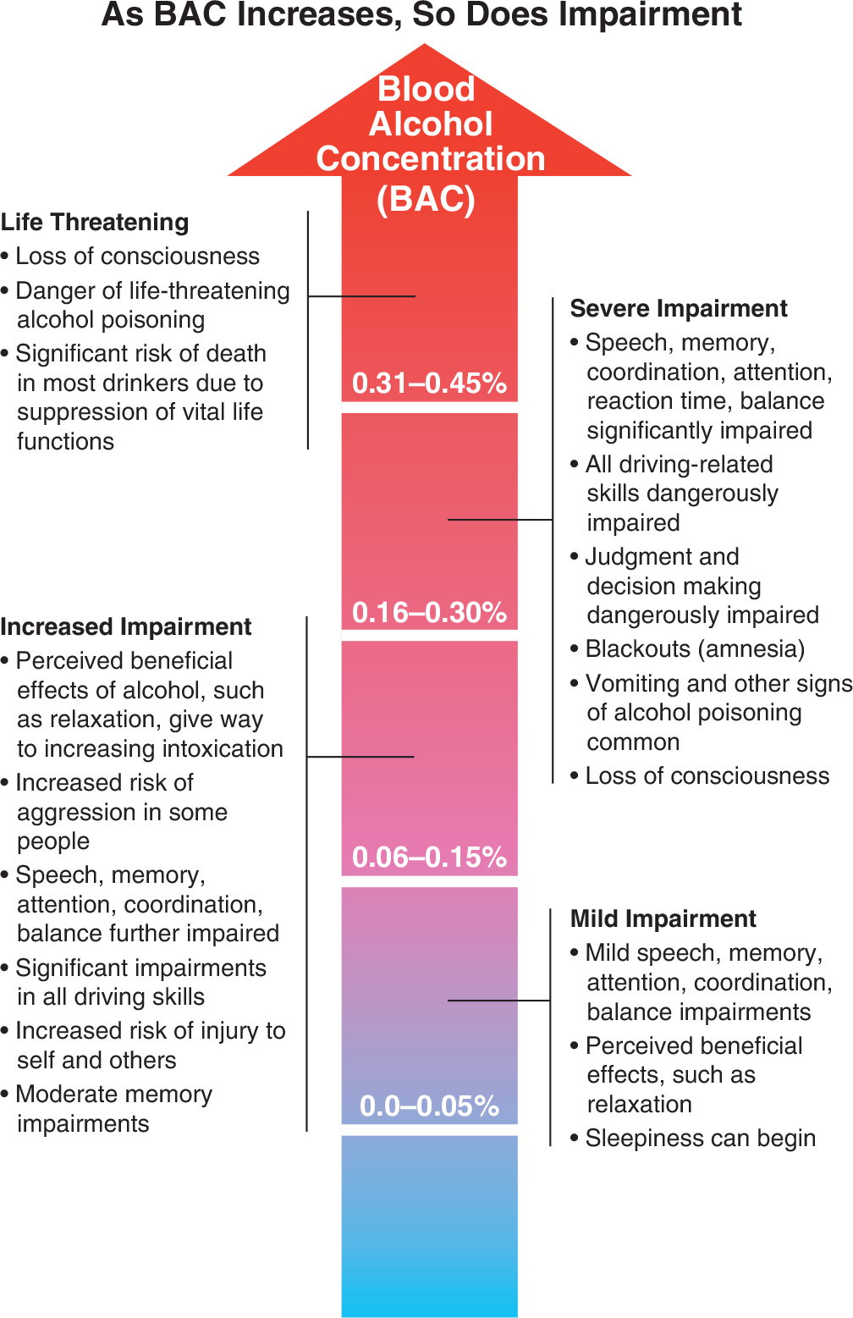
Effects of Alcohol on Brain Activity

Slide 68
In Depth: Alcohol (cont.)
Effects of alcohol abuse:
When the rate of alcohol intake exceeds the ability of the liver to break alcohol down, liver cells are damaged or destroyed
Fatty liver is an early but reversible sign of liver damage
Alcohol hepatitis results in loss of appetite, nausea and vomiting, abdominal pain, and jaundice
Cirrhosis of the liver involves permanent scarring after years of alcohol abuse

Slide 69
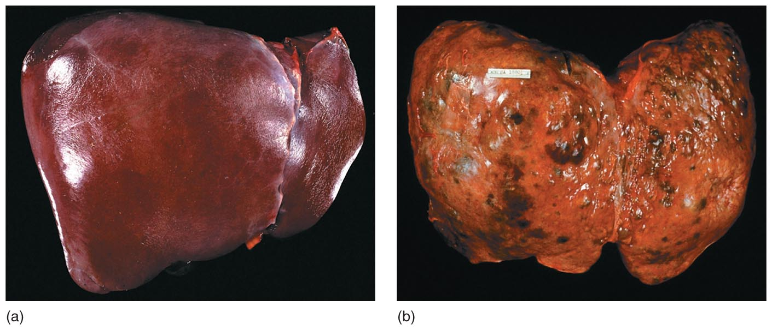
Cirrhosis of the Liver

Slide 70
In Depth: Alcohol (cont.)
Effects of alcohol abuse:
Chronically high intake increases risk for
Impaired bone health
Pancreatic injury and diabetes
Cancer
Abdominal obesity
Malnutrition

Slide 71
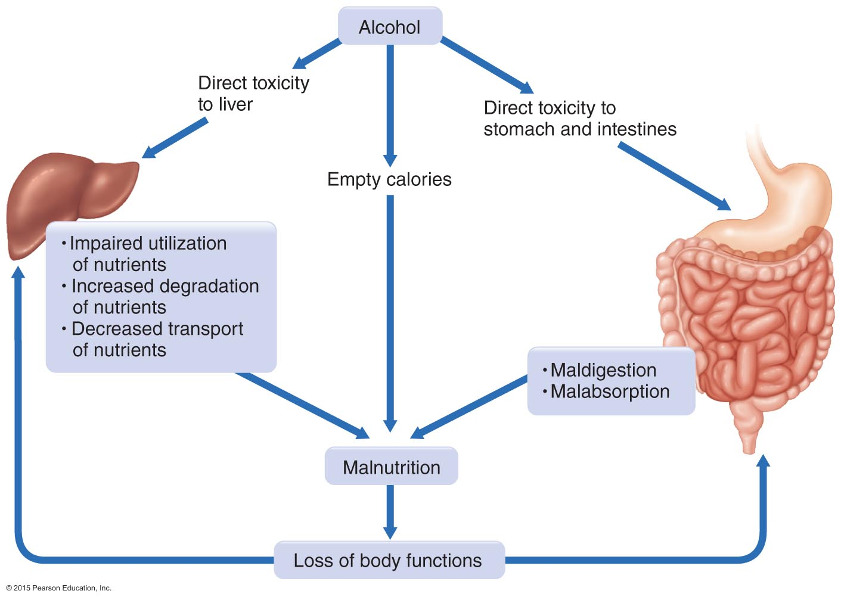
Alcohol-Related Malnutrition

Slide 72
In Depth: Alcohol (cont.)
Fetal and infant health problems include
Fetal alcohol syndrome (FAS), a set of serious, irreversible birth defects, including physical, emotional, behavioral, and developmental problems
Fetal alcohol effects (FAE), subtler consequences that may be exhibited later, including hyperactivity, attention deficit disorder, and impaired learning abilities

Slide 73
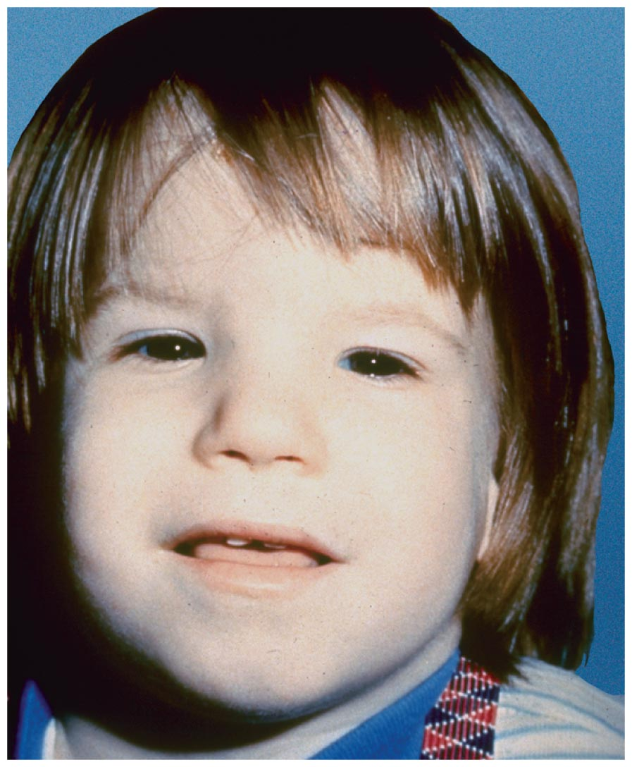
Fetal Alcohol Syndrome (FAS)

Slide 74
In Depth: Alcohol (cont.)
You should be concerned about your alcohol intake if you engage in binge drinking or drink at inappropriate times
Speak with a trusted friend, coach, teacher, counselor, or healthcare provider

